Slide 1
My journal to python
NAME: 艾綺絲
STUDENT ID: 4110E224

Slide 2
Agenda:
PYTHON (INTRODUCTON)
PYTHON COMMENTS
PYTHON VARIABLES
PYTHON NUMBERS
PYTHON CASTING
PYTHON STRINGS
PYTHON OPERATORS
PYTHON LISTS
PYTHON SETS

Slide 3

PYTHON : PYTHON INTRODUCTION
What is Python?
Python is a popular programming language. It was created by Guido van Rossum, and released in 1991.
It is used for:
web development (server-side),
software development,
mathematics,
system scripting.
EXAMPLE:
# This program prints Hello, everyone!
print('Hello, everyone!)

Slide 4

PYTHON: IT IS USE FOR:
Web development (server-side)
Server-side scripting is a technique used in web development which involves employing scripts on a web server which produces a response customized for each user's request to the website. The alternative is for the web server itself to deliver a static web page.

Slide 5

Software development
Python is often used as a support language for software developers, for build control and management, testing, and in many other ways.

Slide 6
Mathematics
Python has a set of built-in math functions, including an extensive math module, that allows you to perform mathematical tasks on numbers.
Numbers
Example:
x = min(5, 10, 25) y = max(5, 10, 25) print(x) print(y)

Slide 7
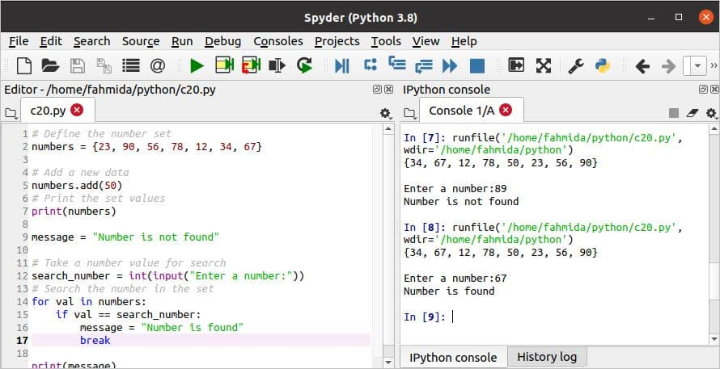
System scripting
Scripting is a very common practice among Python programmers. It's used for automation of daily tasks, reporting, server management, security, social media management, business growth and development, financial trading, automating software and many other intelligent solutions.

Slide 8


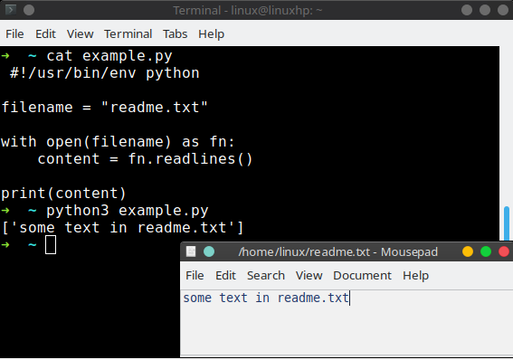
What can Python do?
Python can be used on a server to create web applications.
Python can be used alongside software to create workflows.
Python can connect to database systems. It can also read and modify files.

Slide 9

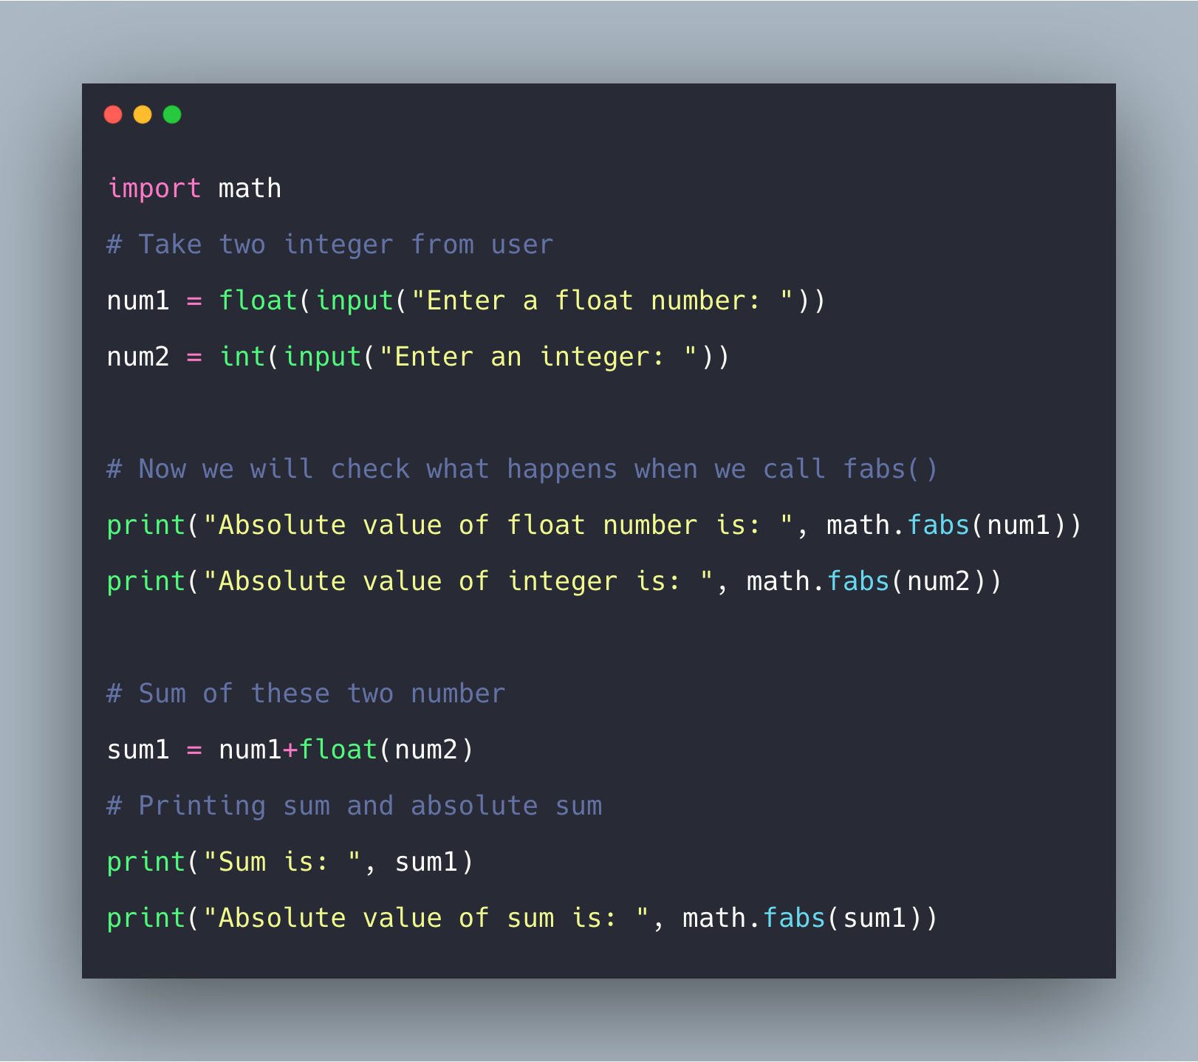

Python can be used to handle big data and perform complex mathematics.
Python can be used for rapid prototyping, or for production-ready software development.

Slide 10
PYTHON COMMENTS
Hash symbol
Comments in Python are identified with a hash symbol, #, and extend to the end of the line.
Comments can be used to explain Python code.
Comments can be used to make the code more readable.
Comments can be used to prevent execution when testing code
EXAMPLE:
#This is a comment print("Hello, Everyone!“)

Slide 11
Python variables
Variables
Variables
Variables are containers for storing data values.
Creating Variables
Python has no command for declaring a variable.
A variable is created the moment you first assign a value to it.
Example
x = 8 y = “Cheska" print(x) print(y)

Slide 12
Python –variable names
Variable name
A variable can have a short name (like x and y) or a more descriptive name (age, carname, total_volume). Rules for Python variables:
A variable name must start with a letter or the underscore character
A variable name cannot start with a number
A variable name can only contain alpha-numeric characters and underscores (A-z, 0-9, and _ )
Variable names are case-sensitive (age, Age and AGE are three different variables)
Example:
myvar = "Cheska"
my_var = "Cheska"
_my_var = "Cheska"
myVar = "Cheska"
MYVAR = "Cheska"
myvar2 = "Cheska"

Slide 13
Python Variables - Assign Multiple Values
Python assigns values from right to left. When assigning multiple variables in a single line, different variable names are provided to the left of the assignment operator separated by a comma. The same goes for their respective values except they should be to the right of the assignment operator.
different variable names
Example:
x, y, z = “Apple", "Strawberry", "Mango" print(x) print(y) print(z)

Slide 14
Python - Output Variables
example:
x = "Flower is beautiful"
print(x)
The Python print() function is often used to output variables.
print() function

Slide 15
Python - Global Variables
Global Variables
Variables that are created outside of a function are known as global variables.
Global variables can be used by everyone, both inside of functions and outside.
example:
x = "beautiful"
def myfunc():
print("Python is " + x)
myfunc()

Slide 16
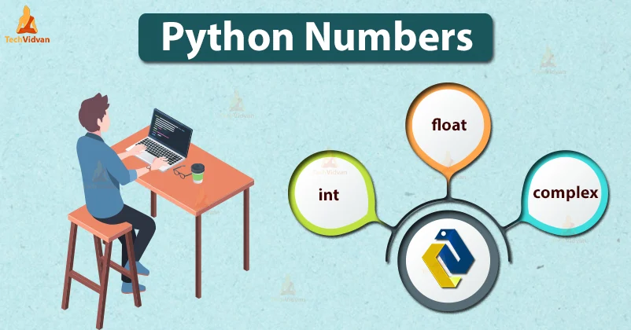
Python numbers
Python supports integers, floating-point numbers and complex numbers. They are defined as int , float , and complex classes in Python. Integers and floating points are separated by the presence or absence of a decimal point. For instance, 5 is an integer whereas 5.0 is a floating-point number.

Slide 17
python: three numeric types
Integer - Int, or integer, is a whole number, positive or negative, without decimals, of unlimited length.
Float - Float, or "floating point number" is a number, positive or negative, containing one or more decimals.
Complex - Complex numbers are written with a "j" as the imaginary part

Slide 18
Integers
Floats
Complex
example
x = 8
y = 1234567891011
z = -109876543
print(type(x))
print(type(y))
print(type(z))
example
x = 2.5
y = 3.7
z = -10.25
print(type(x))
print(type(y))
print(type(z))
example
x = 45e3
y = 43E2
z = -88.e3345
print(type(x))
print(type(y))
print(type(z))

Slide 19
Type Conversion
example:
x = 8 # int
y = 1.5 # float
z = 3j # complex
#convert from int to float:
a = float(x)
#convert from float to int:
b = int(y)
#convert from int to complex:
c = complex(x)
print(a)
print(b)
print(c)
print(type(a))
print(type(b))
print(type(c))
You can convert from one type to another with the int(), float(), and complex() methods

Slide 20
Random Number
example:
import random
print(random.randrange(1, 20))
Python does not have a random() function to make a random number, but Python has a built-in module called random that can be used to make random numbers

Slide 21
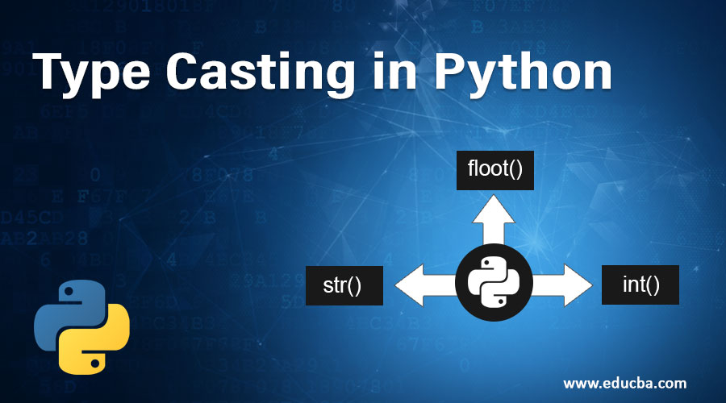
Python Casting
Casting, also known as type conversion, is a process that converts the data type of a variable into another data type.

Slide 22
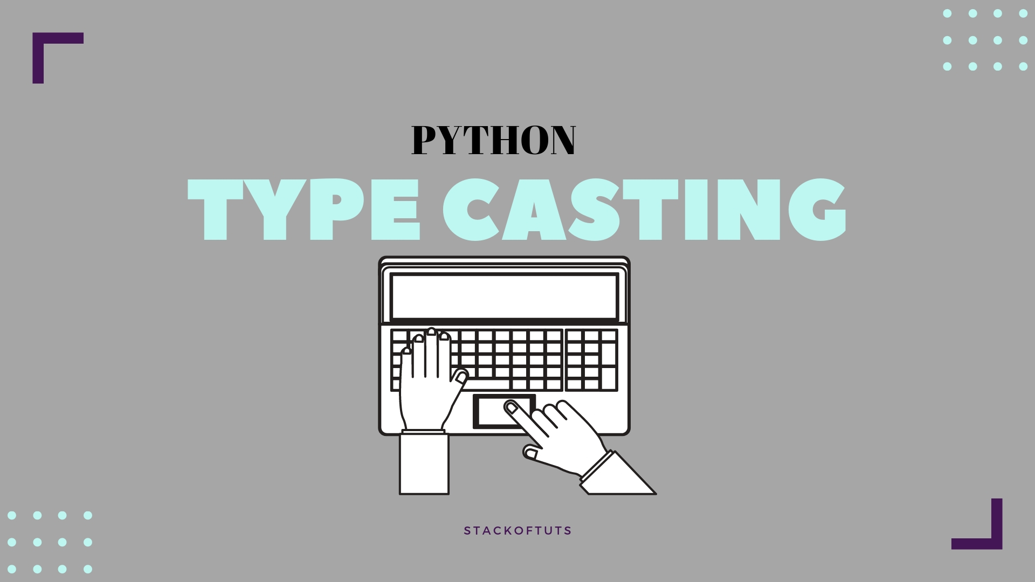
Specify a Variable Type
There may be times when you want to specify a type on to a variable. This can be done with casting. Python is an object-orientated language, and as such it uses classes to define data types, including its primitive types.

Slide 23
Casting in python is therefore done using constructor functions:
int() - constructs an integer number from an integer literal, a float literal (by removing all decimals), or a string literal (providing the string represents a whole number)
float() - constructs a float number from an integer literal, a float literal or a string literal (providing the string represents a float or an integer)
str() - constructs a string from a wide variety of data types, including strings, integer literals and float literals

Slide 24
Integers
Float
String
example
x = int(2) # x will be 1
y = int(5.9) # y will be 2
z = int("6") # z will be 3
example
x = float(2) # x will be 2.0
y = float(5.9) # y will be 5.9
z = float("6") # z will be 6.0
w = float("3.7") # w will be 3.7
example
x = str("s2") # x will be 's2'
y = str(3) # y will be '3'
z = str(4.0) # z will be '4.0'

Slide 25
Python Strings
Strings
Strings in python are surrounded by either single quotation marks, or double quotation marks.
'hello' is the same as "hello".
You can display a string literal with the print() function:
Example:
print("Everyone")
print('Everyone')

Slide 26
Python - Slicing Strings
Slicing
You can return a range of characters by using the slice syntax.
Specify the start index and the end index, separated by a colon, to return a part of the string.
Example:
Get the characters from position 3 to position 6 (not included)
b = "Hello, Everyone!"
print(b[3:6])

Slide 27
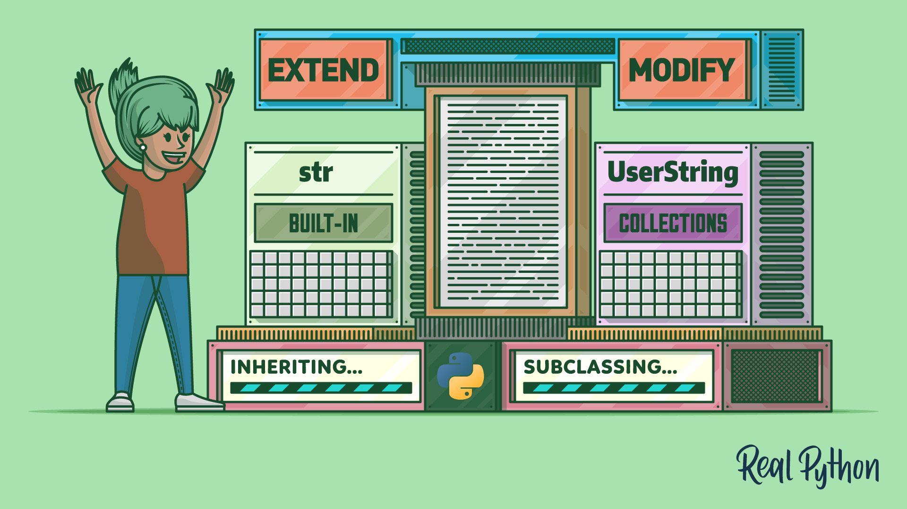
Python - Modify Strings
Python has a set of built-in methods that you can use on strings.

Slide 28
EXAMPLES
Upper case
Lower case
example
The upper() method returns the string in upper case:
a = "Hello, Everyone!"
print(a.upper())
example
The lower() method returns the string in lower case:
a = "Hello, Everyone!"
print(a.lower())

Slide 29
Remove Whitespace
Whitespace is the space before and/or after the actual text, and very often you want to remove this space
example
The strip() method removes any whitespace from the beginning or the end:
a = " Hello, Everyone! "
print(a.strip()) # returns "Hello, Everyone!"

Slide 30
Replace String
Split String
The split() method returns a list where the text between the specified separator becomes the list items.
example
The split() method splits the string into substrings if it finds instances of the separator:
a = "Hello, Everyone!"
print(a.split(",")) # returns ['Hello', ' Everyone!']
example
The replace() method replaces a string with another string:
a = "Hello, Everyone"
print(a.replace("H", "Y"))

Slide 31
Python - String Concatenation
String Concatenation
String concatenation means add strings together.
Use the + character to add a variable to another variable
example
x = "Flower is "
y = "beautiful"
z = x + y
print(z)

Slide 32
Merge variable a with variable b into variable c
To add a space between them, add a " ":
example
a = "Hello"
b = "Everyone"
c = a + b
print(c)
example
a = "Hello"
b = "World"
c = a + " " + b
print(c)

Slide 33
For numbers, the + character works as a mathematical operator:
If you try to combine a string and a number, Python will give you an error:
example
x = 8
y = 12
print(x + y)
example
x =8
y = "Cheska"
print(x + y)

Slide 34
Python - Format - Strings
String Format
As we learned in the Python Variables chapter, we cannot combine strings and numbers like this
example
age = 19
txt = "My name is Cheska, I am " + age
print(txt)

Slide 35
But we can combine strings and numbers by using the format() method!
The format() method takes the passed arguments, formats them, and places them in the string where the placeholders {} are:
example
Use the format() method to insert numbers into strings:
age = 19
txt = "My name is Cheska, and I am {}"
print(txt.format(age))

Slide 36
The format() method takes unlimited number of arguments, and are placed into the respective placeholders:
example
quantity = 8
itemno = 897
price = 28.98
myorder = "I want {} pieces of item {} for {} dollars."
print(myorder.format(quantity, itemno, price))

Slide 37
You can use index numbers {0} to be sure the arguments are placed in the correct placeholders:
example
quantity = 8
itemno = 897
price = 28.98
myorder = "I want to pay {2} dollars for {0} pieces of item {1}."
print(myorder.format(quantity, itemno, price))

Slide 38
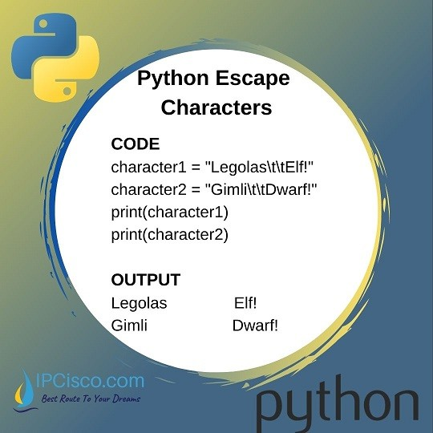
Python - Escape Characters
Escape Character
To insert characters that are illegal in a string, use an escape character.
An escape character is a backslash \ followed by the character you want to insert.

Slide 39
An example of an illegal character is a double quote inside a string that is surrounded by double quotes:
example
You will get an error if you use double quotes inside a string that is surrounded by double quotes:
txt = "We are the so-called "Vikings" from the north."

Slide 40
To fix this problem, use the escape character \":
example
The escape character allows you to use double quotes when you normally would not be allowed:
txt = "We are the so-called \"Vikings\" from the north."

Slide 41
Escape Characters Other escape characters used in Python:
Code | Result
\' \\ \n \r \t \b \f \ooo \xhh
Single Quote Backslash New Line Carriage Return Tab Backspace Form Feed Octal Value Hex Value

Slide 42
Python - String Methods
String Methods
Python has a set of built-in methods that you can use on strings.
Note: All string methods return new values. They do not change the original string.

Slide 43
Method | Description
capitalize() | Converts the first character to upper case
casefold() | Converts string into lower case
center() | Returns a centered string
count() | Returns the number of times a specified value occurs in a string
encode() | Returns an encoded version of the string
endswith() | Returns true if the string ends with the specified value
expandtabs() | Sets the tab size of the string
find() | Searches the string for a specified value and returns the position of where it was found
format() | Formats specified values in a string
format_map() | Formats specified values in a string

Slide 44
index() | Searches the string for a specified value and returns the position of where it was found
isalnum() | Returns True if all characters in the string are alphanumeric
isalpha() | Returns True if all characters in the string are in the alphabet
isdecimal() | Returns True if all characters in the string are decimals
isdigit() | Returns True if all characters in the string are digits
isidentifier() | Returns True if the string is an identifier
islower() | Returns True if all characters in the string are lower case
isnumeric() | Returns True if all characters in the string are numeric
isprintable() | Returns True if all characters in the string are printable
isspace() | Returns True if all characters in the string are whitespaces
istitle() | Returns True if the string follows the rules of a title

Slide 45
isupper() | Returns True if all characters in the string are upper case
join() | Joins the elements of an iterable to the end of the string
ljust() | Returns a left justified version of the string
lower() | Converts a string into lower case
lstrip() | Returns a left trim version of the string
maketrans() | Returns a translation table to be used in translations
partition() | Returns a tuple where the string is parted into three parts
replace() | Returns a string where a specified value is replaced with a specified value
rfind() | Searches the string for a specified value and returns the last position of where it was found
rindex() | Searches the string for a specified value and returns the last position of where it was found
rjust() | Returns a right justified version of the string

Slide 46
rpartition() | Returns a tuple where the string is parted into three parts
rsplit() | Splits the string at the specified separator, and returns a list
rstrip() | Returns a right trim version of the string
split() | Splits the string at the specified separator, and returns a list
splitlines() | Splits the string at line breaks and returns a list
startswith() | Returns true if the string starts with the specified value
strip() | Returns a trimmed version of the string
swapcase() | Swaps cases, lower case becomes upper case and vice versa
title() | Converts the first character of each word to upper case
translate() | Returns a translated string
upper() | Converts a string into upper case
zfill() | Fills the string with a specified number of 0 values at the beginning

Slide 47
Python Operators
Python Operators
Operators are used to perform operations on variables and values.
In the example below, we use the + operator to add together two values:
+ operator
Example
print(18 + 8)

Slide 48
Python divides the operators in the following groups:
Arithmetic operators
Assignment operators
Comparison operators
Logical operators
Identity operators
Membership operators
Bitwise operators

Slide 49
Python Arithmetic Operators
Arithmetic operators are used with numeric values to perform common mathematical operations:
Operator | Name | Example
+ | Addition | x + y
- | Subtraction | x - y
* | Multiplication | x * y
/ | Division | x / y
% | Modulus | x % y
** | Exponentiation | x ** y
// | Floor Division | x // y

Slide 50
Python Assignment Operators
Assignment operators are used to assign values to variables:
Operator | Example | Same As
= | x = 5 | x = x = 5
+= | x += 3 | x = x + 3
-= | x -= 3 | x = x - 3
*= | x *= 3 | x = x * 3
/= | x /= 3 | x = x / 3
%= | x %= 3 | x = x % 3
//= | x //= 3 | x = x // 3
**= | x **= 3 | x = x ** 3
&= | x &= 3 | x = x & 3
|= | x |= 3 | x = x | 3
^= | x ^= 3 | x = x ^ 3
>>= | x >>= 3 | x = x >> 3
<<= | x <<= 3 | x = x << 3

Slide 51
Python Comparison Operators
Comparison operators are used to compare two values:
Operator | Name | Example
== | Equal | x == y
!= | Not equal | x != y
> | Greater than | x > y
< | Less than | x < y
>= | Greater than or equal to | x >= y
<= | Less than or equal to | x <= y

Slide 52
Python Logical Operators
Logical operators are used to combine conditional statements:
Operator | Description | Example
and | Returns True if both statements are true | x < 5 and x < 10
or | Returns True if one of the statements is true | x < 5 or x < 4
not | Reverse the result, returns False if the result is true | not(x < 5 and x < 10)

Slide 53
Python Identity Operators
Identity operators are used to compare the objects, not if they are equal, but if they are actually the same object, with the same memory location:
Operator | Description | Example
is | Returns True if both variables are the same object | x is y
is not | Returns True if both variables are not the same object | x is not y

Slide 54
Python Membership Operators
Membership operators are used to test if a sequence is presented in an object:
Operator | Description | Example
in | Returns True if a sequence with the specified value is present in the object | x in y
not in | Returns True if a sequence with the specified value is present in the object | x not in y

Slide 55
Python Bitwise Operators
Bitwise operators are used to compare (binary) numbers:
Operator | Name | Description
& | AND | Sets each bit to 1 if both bits are 1
| | OR | Sets each bit to 1 if one of two bits is 1
^ | XOR | Sets each bit to 1 if only one of two bits is 1
~ | NOT | Inverts all the bits
<< | Zero fill left shift | Shift left by pushing zeros in from the right and let the leftmost bits fall off
>> | Signed right shift | Shift right by pushing copies of the leftmost bit in from the left, and let the rightmost bits fall off

Slide 56
Python Lists
List
Lists are used to store multiple items in a single variable.
Lists are one of 4 built-in data types in Python used to store collections of data, the other 3 are Tuple, Set, and Dictionary, all with different qualities and usage.
mylist = ["strawberry", "grapes", "orange"]

Slide 57
Lists are created using square brackets:
Example
Create a List:
thislist = ["strawberry", "grapes", "orange"]
print(thislist)

Slide 58
List Items
List items are ordered, changeable, and allow duplicate values.
List items are indexed, the first item has index [0], the second item has index [1] etc.

Slide 59
Ordered
When we say that lists are ordered, it means that the items have a defined order, and that order will not change.
If you add new items to a list, the new items will be placed at the end of the list.
Note: There are some list methods that will change the order, but in general: the order of the items will not change.

Slide 60
Changeable
The list is changeable, meaning that we can change, add, and remove items in a list after it has been created.

Slide 61
Allow Duplicates
Since lists are indexed, lists can have items with the same value:
Example
Lists allow duplicate values:
thislist = ["strawberry", "grapes", "orange", "strawberry", "orange"]
print(thislist)

Slide 62
List Length
To determine how many items a list has, use the len() function:
Example
Print the number of items in the list:
thislist = ["strawberry", "grapes", "orange"]
print(len(thislist))

Slide 63
List Items - Data Types
List items can be of any data type:
Example
String, int and boolean data types:
list1 = ["apple", "banana", "cherry"]
list2 = [1, 5, 7, 9, 3]
list3 = [True, False, False]

Slide 64
A list can contain different data types:
Example
A list with strings, integers and boolean values:
list1 = ["abc", 34, True, 40, "male"]

Slide 65
type()
From Python's perspective, lists are defined as objects with the data type 'list':
<class 'list'>
Example
What is the data type of a list?
mylist = ["apple", "banana", "cherry"]
print(type(mylist))

Slide 66
The list() Constructor
It is also possible to use the list() constructor when creating a new list.
Example
Using the list() constructor to make a List:
thislist = list(("strawberry", "grapes", "orange")) # note the double round-brackets
print(thislist)

Slide 67
Python Collections (Arrays)
There are four collection data types in the Python programming language:
List is a collection which is ordered and changeable. Allows duplicate members.
Tuple is a collection which is ordered and unchangeable. Allows duplicate members.
Set is a collection which is unordered, unchangeable*, and unindexed. No duplicate members.
Dictionary is a collection which is ordered** and changeable. No duplicate members.

Slide 68
Python - Access List Items
Access Items
List items are indexed and you can access them by referring to the index number:
Example
Print the second item of the list:
thislist = ["strawberry", "grapes", "orange"]
print(thislist[1])

Slide 69
Negative Indexing
Negative indexing means start from the end
-1 refers to the last item, -2 refers to the second last item etc.
Example
Print the last item of the list:
thislist = ["strawberry", "grapes", "orange"]
print(thislist[-1])

Slide 70
Range of Indexes
You can specify a range of indexes by specifying where to start and where to end the range.
When specifying a range, the return value will be a new list with the specified items.
Example
Return the third, fourth, and fifth item:
thislist = ["strawberry", "grapes", "lemon", "peach", "guava", "avocado", "papaya"]
print(thislist[2:5])

Slide 71
Note: The search will start at index 2 (included) and end at index 5 (not included).
Remember that the first item has index 0.
By leaving out the start value, the range will start at the first item:
Example
This example returns the items from the beginning to, but NOT including, "guava":
thislist = ["strawberry", "grapes", "lemon", "peach", "guava", "avocado", "papaya"]
print(thislist[:4])

Slide 72
By leaving out the end value, the range will go on to the end of the list:
Example
This example returns the items from "lemon" to the end:
thislist = ["strawberry", "grapes", "lemon", "peach", "guava", "avocado", "papaya"]
print(thislist[2:])

Slide 73
Range of Negative Indexes
Specify negative indexes if you want to start the search from the end of the list:
Example
This example returns the items from "peach" (-4) to, but NOT including "papaya" (-1):
thislist = ["strawberry", "grapes", "lemon", "peach", "guava", "avocado", "papaya"]
print(thislist[-4:-1])

Slide 74
Check if Item Exists
To determine if a specified item is present in a list use the in keyword:
Example
Check if "strawberry" is present in the list:
thislist = ["strawberry", "grapes", "orange"]
if "apple" in thislist:
print("Yes, 'strawberry' is in the fruits list")

Slide 75
Python - Change List Items
Change Item Value
To change the value of a specific item, refer to the index number:
Example
Change the second item:
thislist = ["strawberry", "grapes", "orange"]
thislist[1] = "lemon"
print(thislist)

Slide 76
Change a Range of Item Values
To change the value of items within a specific range, define a list with the new values, and refer to the range of index numbers where you want to insert the new values:
Example
Change the values "banana" and "cherry" with the values "blackcurrant" and "watermelon":
thislist = ["apple", "banana", "cherry", "orange", "kiwi", "mango"]
thislist[1:3] = ["blackcurrant", "watermelon"]
print(thislist)

Slide 77
If you insert more items than you replace, the new items will be inserted where you specified, and the remaining items will move accordingly:
Example
Change the second value by replacing it with two new values:
thislist = ["apple", "banana", "cherry"]
thislist[1:2] = ["blackcurrant", "watermelon"]
print(thislist)

Slide 78
If you insert less items than you replace, the new items will be inserted where you specified, and the remaining items will move accordingly:
Example
Change the second and third value by replacing it with one value:
thislist = ["apple", "banana", "cherry"]
thislist[1:3] = ["watermelon"]
print(thislist)

Slide 79
Insert Items
To insert a new list item, without replacing any of the existing values, we can use the insert() method.
The insert() method inserts an item at the specified index:
Example
Insert "watermelon" as the third item:
thislist = ["apple", "banana", "cherry"]
thislist.insert(2, "watermelon")
print(thislist)

Slide 80
Python - Add List Items
Append Items
To add an item to the end of the list, use the append() method:
Example
Using the append() method to append an item:
thislist = ["apple", "banana", "cherry"]
thislist.append("orange")
print(thislist)

Slide 81
Insert Items
To insert a list item at a specified index, use the insert() method.
The insert() method inserts an item at the specified index:
Example
Insert an item as the second position:
thislist = ["red", "yellow", "green"]
thislist.insert(1, "blue")
print(thislist)
Note: As a result of the examples above, the lists will now contain 4 items.

Slide 82
Extend List
To append elements from another list to the current list, use the extend() method.
Example
Add the elements of tropical to thislist:
thislist = ["strawberry", "grapes", "orange"]
tropical = ["lemon", "melon", "guava"]
thislist.extend(tropical)
print(thislist)
The elements will be added to the end of the list.

Slide 83
Add Any Iterable
The extend() method does not have to append lists, you can add any iterable object (tuples, sets, dictionaries etc.).
Example
Add elements of a tuple to a list:
thislist = ["red", "blue", "orange"]
thistuple = ("yellow", "green")
thislist.extend(thistuple)
print(thislist)

Slide 84
Python - Remove List Items
Remove Specified Item
The remove() method removes the specified item.
Example
Remove "banana":
thislist = ["apple", "banana", "cherry"]
thislist.remove("banana")
print(thislist)

Slide 85
Remove Specified Index
The pop() method removes the specified index.
Example
Remove the second item:
thislist = ["apple", "banana", "cherry"]
thislist.pop(1)
print(thislist)
If you do not specify the index, the pop() method removes the last item.

Slide 86
If you do not specify the index, the pop() method removes the last item.
Example
Remove the last item:
thislist = ["blue", "red", "yellow"]
thislist.pop()
print(thislist)

Slide 87
The del keyword also removes the specified index:
Example
Remove the last item:
thislist = ["blue", "red", "yellow"]
del thislist[0]
print(thislist)

Slide 88
The del keyword can also delete the list completely.
Example
Delete the entire list:
thislist = ["red", "yellow", "blue"]
del thislist

Slide 89
Clear the List
The clear() method empties the list.
The list still remains, but it has no content.
Example
Clear the list content:
thislist = ["red", "blue", "yellow"]
thislist.clear()
print(thislist)

Slide 90
Python - Loop Lists
Loop Through a List
You can loop through the list items by using a for loop:
Example
Print all items in the list, one by one:
thislist = ["red", "blue", "yellow"]
for x in thislist:
print(x)

Slide 91
Loop Through the Index Numbers
You can also loop through the list items by referring to their index number.
Use the range() and len() functions to create a suitable iterable.
Example
Print all items by referring to their index number:
thislist = ["apple", "banana", "cherry"]
for i in range(len(thislist)):
print(thislist[i])
The iterable created in the example above is [0, 1, 2].

Slide 92
Using a While Loop
You can loop through the list items by using a while loop.
Use the len() function to determine the length of the list, then start at 0 and loop your way through the list items by referring to their indexes.
Remember to increase the index by 1 after each iteration.

Slide 93
Example
Print all items, using a while loop to go through all the index numbers
thislist = ["apple", "banana", "cherry"]
i = 0
while i < len(thislist):
print(thislist[i])
i = i + 1

Slide 94
Looping Using List Comprehension
List Comprehension offers the shortest syntax for looping through lists:
Example
A short hand for loop that will print all items in a list:
thislist = ["red", "blue", "yellow"]
[print(x) for x in thislist]

Slide 95
Python - List Comprehension
List Comprehension
List comprehension offers a shorter syntax when you want to create a new list based on the values of an existing list.
Example:
Based on a list of fruits, you want a new list, containing only the fruits with the letter "a" in the name.
Without list comprehension you will have to write a for statement with a conditional test inside:

Slide 96
Example
fruits = ["apple", "banana", "cherry", "kiwi", "mango"]
newlist = []
for x in fruits:
if "a" in x:
newlist.append(x)
print(newlist)

Slide 97
With list comprehension you can do all that with only one line of code:
Example
fruits = ["apple", "banana", "cherry", "kiwi", "mango"]
newlist = [x for x in fruits if "a" in x]
print(newlist)

Slide 98
The Syntax
newlist = [expression for item in iterable if condition == True]
The return value is a new list, leaving the old list unchanged.

Slide 99
Condition
The condition is like a filter that only accepts the items that valuate to True.
Example
A short hand for loop that will print all items in a list:
thislist = ["red", "blue", "yellow"]
[print(x) for x in thislist]

Slide 100
The condition if x != "apple" will return True for all elements other than "apple", making the new list contain all fruits except "apple".
The condition is optional and can be omitted:
Example
With no if statement:
newlist = [x for x in fruits]

Slide 101
Iterable
The iterable can be any iterable object, like a list, tuple, set etc.
Example
You can use the range() function to create an iterable:
newlist = [x for x in range(10)
Same example, but with a condition:
Example
Accept only numbers lower than 5:
newlist = [x for x in range(10) if x < 5]

Slide 102
Expression
The expression is the current item in the iteration, but it is also the outcome, which you can manipulate before it ends up like a list item in the new list:
Example
Set the values in the new list to upper case:
newlist = [x.upper() for x in fruits]

